Slide 1
Team Eclectic
Project Linphone-Waterfall

Slide 2
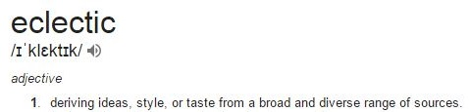
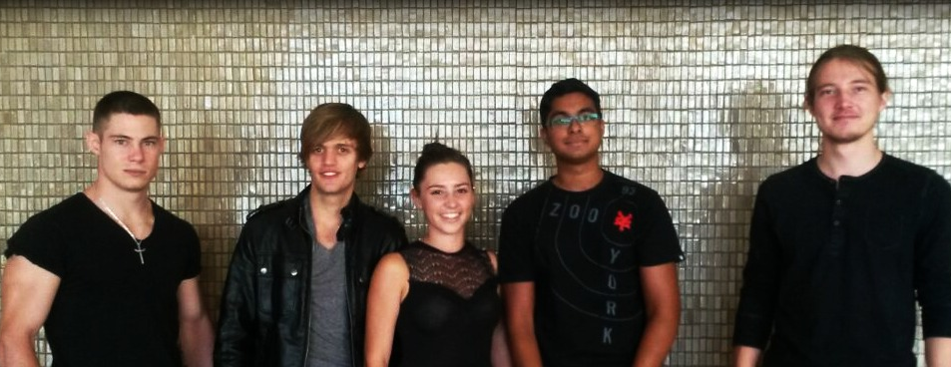
Team Eclectic

Slide 3


The Client

Slide 4
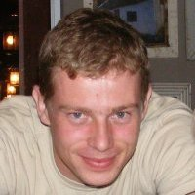
The Client 2.0
Kobus Coetzee
BEng 2006
Currently: Masters

Slide 5

Client – Team Interaction

Slide 6

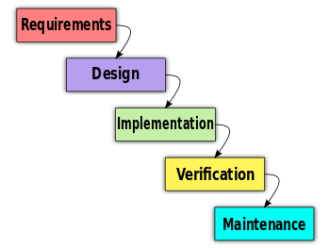

The Project: Linphone Waterfall
DO-178

Slide 7
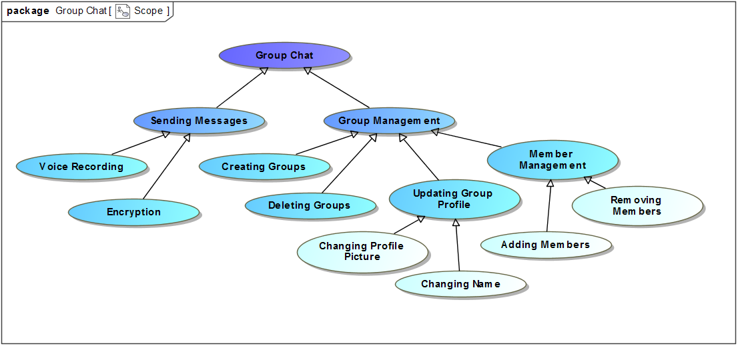
The Project: Scope

Slide 8
Timeline
Plan for Software Aspects of Certification (PSAC)
Software Design Document (SDD)
PSAC - 19 June → 1 July
SDD - → 14 July
Coding - 15 July →
Testing - August
Documentation - Follow Testing

Slide 9

Thank You

